Slide 1
Data DOJO presentation
You can talk about data dojo out of data dojo
August 2024
Data practice team,
Avantage Reply Luxembourg
Notes:
MIFID & EMIR are 2 pillars of European financial regulation. The have a major impact on the activities of financial institutions.
This is why we wanted to hold this session, to introduce these 2 to those who aren’t yet familiar with. And to provide a refresh for the others.

Slide 2

CONTENTS
Preliminary Notions
Different falvours of SQL
Let's get it started

Slide 3
I. Preliminary Notions

Slide 4
What is a database : A database is a structured set of data stored on a computer. Databases should be organized to efficiently store, retrieve, and manage information.
What is a data whare house : A data warehouse, or enterprise data warehouse (EDW), is a system that aggregates data from different sources into a single, central, consistent data store to support data analysis, data mining, artificial intelligence (AI) and machine learning. A data warehouse system enables an organization to run powerful analytics on large amounts of data in ways that a standard database cannot.
DIsclaimer: we are focusing on SQL in general, beside we are normally involved in Data Ware House based- missions
What is SQL : SQL is a domain-specific language used to manage data, especially in a relational database management system (RDBMS)
Branches of SQL:
SQL is divided into various sublanguages, each designed for a specific purpose in interacting with and managing data in an SQL database.
DML , DDL , DQL , DCL (out of scope for this course), TCL (out of scope for this course)

Slide 5
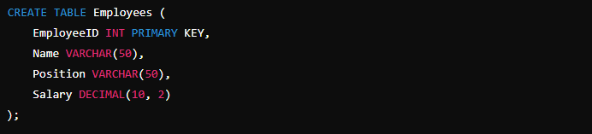
DML (Data Manipulation Language)
Purpose: Deals with the manipulation of data within the database.
Key Commands: INSERT, UPDATE, DELETE, SELECT
Example: Inserting data into a table
DDL (Data Definition Language)
Purpose: Defines the structure of the database, such as creating, altering, and dropping tables.
Key Commands: CREATE, ALTER, DROP, TRUNCATE
Example: Creating a table.

Slide 6

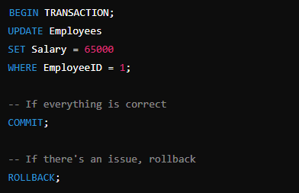
DQL (Data Query Language)
Purpose: Focuses on querying data from the database.
Key Commands: SELECT
Example: Querying data from a table.
DCL (Data Control Language)
Purpose: Deals with rights, permissions, and other controls of the database.
Key Commands: GRANT, REVOKE
Example: Granting permission to a user.
TCL (Transaction Control Language)
Purpose: Deals with the transactions within a database, ensuring they are executed reliably.
Key Commands: COMMIT, ROLLBACK, SAVEPOINT
Example: Managing transactions.

Slide 7
Data Base
A database is an organized collection of data that is stored and accessed electronically
Databases are structured to allow efficient storage, retrieval, and management of data. Often a good data base implementation is crucial to the fast and efficient implementation of application

Slide 8
Data Bases: yes, you do interact with them everyday
Let’s think to a generic social media, and let’s suppose that, among others, the social media has these two tables:
- Posts (it stores al the information about the posts: datetime, owner, image_url….)
- users (that contains the information about the user and, among them, the pwd)

Slide 9
Data Bases: yes, you do interact with them everyday
User Interaction: When a user logs in, the Users table is queried to authenticate the user.
Posting: When a user creates a new post, a new record is added to the Posts table.
Note: in this course we will consider exclusively RELATIONAL DATA MANAGEMENT SYSTEMS

Slide 10
Data Whare House
A Data Ware House is a centralized repository designed to store large volumes of data from various sources, both current and historical.
Normally a group of users inside an organisation can ask to collect data from several sources (current and historical) and reorganise the collection making it adapt to their neeeds. For example financial reporting or risk analysis

Slide 11
II. Different flavors of SQL

Slide 12



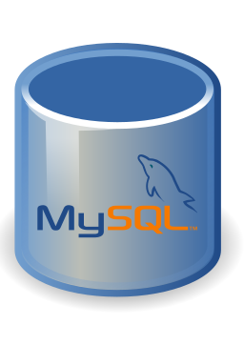

Slide 13
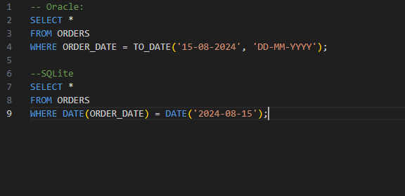
In most of the banks, you will use these versions of SQL:
Oracle (sun microsystem)
Microsoft SQL Server (Microsoft)
But for our lerning path, we will focalise more on SQLite, because is really straight fowrward to install and maintain on our machines. Does it change something? Yes, but not a big deal:

Slide 14
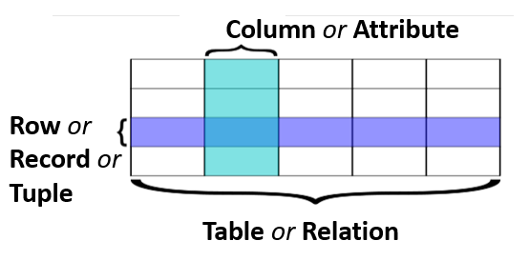
But same concept:
All what you want to consider is a table, with ist rows and columns.
You will hear refer to them as variables or attributes (for columns) and observation or assignation or recordrs (for rows). But what you want actually to remember, is that often you need to manipulate "slices" and "layers" from a table
https://uwescience.github.io/SQL-geospatial-tutorial/01-databaseIntroduction/

Slide 15
Let's get it started: donwload and installation
SQLite: https://www.sqlite.org/download.html
DB browser: https://sqlitebrowser.org/
Our repository: https://github.com/ARLDATADOJO/SQLBASE

Slide 16
Let's get it started: download from repository
From the repository download the file:DATA_DOJO_V2.sqbpro and use the db broser to import the data.
In the same repository, you find the file exercises dojo (no solution) 1.sql and execute the exercises contained in this one

Slide 17
Thanks for your attention

